Slide 1
Expressing Data Locality and Optimizations with OpenACC
OpenACC Course: Lecture 3, October 29, 2015

Slide 2
Oct 1: Introduction to OpenACC
Oct 6: Office Hours
Oct 15: Profiling and Parallelizing with the OpenACC Toolkit
Oct 20: Office Hours
Oct 29: Expressing Data Locality and Optimizations with OpenACC
Nov 3: Office Hours
Nov 12: Advanced OpenACC Techniques
Nov 24: Office Hours
Course Syllabus

Slide 3
Review: Parallelizing with OpenACC and Unified Memory.
Expressing Data Movement
Optimizing Loops
Next Steps & Homework
Agenda

Slide 4
Identify Available Parallelism
Express Parallelism
Express Data Movement
Optimize Loop Performance

Slide 5
Lab 2 Results (Lower is better)
Time (s)
PGI 15.9 Compiler

Slide 6
Identify Available Parallelism
Express Parallelism
Express Data Movement
Optimize Loop Performance

Slide 7
Expressing Data Management

Slide 8
Making Data Management Explicit
We used CUDA Unified Memory to simplify the first steps in accelerating our code.
This made the process simple, but it also made the code not portable
PGI-only: –ta=tesla:managed flag
NVIDIA-only: CUDA Unified Memory
Explicitly managing data will make the code portable and may improve performance.
With Unified Memory
Unified Memory

Slide 9
Structured Data Regions
The data directive defines a region of code in which GPU arrays remain on the GPU and are shared among all kernels in that region.
#pragma acc data
{
#pragma acc parallel loop
...
#pragma acc parallel loop
...
}
Arrays used within the data region will remain on the GPU until the end of the data region.
Data Region

Slide 10
Structured Data Regions
The data directive defines a region of code in which GPU arrays remain on the GPU and are shared among all kernels in that region.
!$acc data
!$acc parallel loop
...
!$acc parallel loop
...
!$acc end data
Arrays used within the data region will remain on the GPU until the end of the data region.
Data Region

Slide 11
Unstructured Data Directives
Used to define data regions when scoping doesn’t allow the use of normal data regions (e.g. the constructor/destructor of a class).
enter data Defines the start of an unstructured data lifetime
clauses: copyin(list), create(list)
exit data Defines the end of an unstructured data lifetime
clauses: copyout(list), delete(list)
#pragma acc enter data copyin(a)
...
#pragma acc exit data delete(a)

Slide 12
Unstructured Data: C++ Classes
class Matrix {
Matrix(int n) {
len = n;
v = new double[len];
#pragma acc enter data
create(v[0:len])
}
~Matrix() {
#pragma acc exit data
delete(v[0:len])
delete[] v;
}
private:
double* v;
int len;
};
Unstructured Data Regions enable OpenACC to be used in C++ classes
Unstructured data regions can be used whenever data is allocated and initialized in a different scope than where it is freed (e.g. Fortran modules).

Slide 13
Data Clauses
copyin ( list ) | Allocates memory on GPU and copies data from host to GPU when entering region.
copyout ( list ) | Allocates memory on GPU and copies data to the host when exiting region.
copy ( list ) | Allocates memory on GPU and copies data from host to GPU when entering region and copies data to the host when exiting region. (Structured Only)
create ( list ) | Allocates memory on GPU but does not copy.
delete( list ) | Deallocate memory on the GPU without copying. (Unstructured Only)
present ( list ) | Data is already present on GPU from another containing data region.

Slide 14
Array Shaping
Compiler sometimes cannot determine size of arrays
Must specify explicitly using data clauses and array “shape”
Partial arrays must be contiguous
C/C++
#pragma acc data copyin(a[0:nelem]) copyout(b[s/4:3*s/4])
Fortran
!$acc data copyin(a(1:end)) copyout(b(s/4:3*s/4))

Slide 15
Coursework : Expressing Data Movement

Slide 16
Explicit Data Movement: Copy In Matrix
void allocate_3d_poission_matrix(matrix &A, int N) {
int num_rows=(N+1)*(N+1)*(N+1);
int nnz=27*num_rows;
A.num_rows=num_rows;
A.row_offsets = (unsigned int*) \
malloc((num_rows+1)*sizeof(unsigned int));
A.cols = (unsigned int*)malloc(nnz*sizeof(unsigned int));
A.coefs = (double*)malloc(nnz*sizeof(double));
// Initialize Matrix
A.row_offsets[num_rows]=nnz;
A.nnz=nnz;
#pragma acc enter data copyin(A)
#pragma acc enter data \
copyin(A.row_offsets[:num_rows+1],A.cols[:nnz],A.coefs[:nnz])
}
After allocating and initializing our matrix, copy it to the device.
Copy the structure first and its members second.

Slide 17
Explicit Data Movement: Delete Matrix
void free_matrix(matrix &A) {
unsigned int *row_offsets=A.row_offsets;
unsigned int * cols=A.cols;
double * coefs=A.coefs;
#pragma acc exit data delete(A.row_offsets,A.cols,A.coefs)
#pragma acc exit data delete(A)
free(row_offsets);
free(cols);
free(coefs);
}
Before freeing the matrix, remove it from the device.
Delete the members first, then the structure.
Lab 3: Next do the same for the vector.

Slide 18
OpenACC present clause
function main(int argc, char **argv)
{
#pragma acc data copy(A)
{
laplace2D(A,n,m);
}
}
When managing the memory at a higher level, it’s necessary to inform the compiler that data is already present on the device.
Local variables should still be declared in the function where they’re used.
High-level data management and the present clause are often critical to good performance.
function laplace2D(double[N][M] A,n,m)
{
#pragma acc data present(A[n][m]) create(Anew)
while ( err > tol && iter < iter_max ) {
err=0.0;
...
}
}

Slide 19
Explicit Data Movement: Present Clause
#pragma acc kernels \
present(row_offsets,cols,Acoefs,xcoefs,ycoefs)
{
for(int i=0;i<num_rows;i++) {
double sum=0;
int row_start=row_offsets[i];
int row_end=row_offsets[i+1];
for(int j=row_start;j<row_end;j++) {
unsigned int Acol=cols[j];
double Acoef=Acoefs[j];
double xcoef=xcoefs[Acol];
sum+=Acoef*xcoef;
}
ycoefs[i]=sum;
}
}
At the compute regions (kernels or parallel loop) inform the compiler that the data is already present.
Lab 3: Do the same for the waxpy and dot functions on the vector.

Slide 20

Running With Explicit Memory Management
Rebuild the code without managed memory. Change –ta=tesla:managed to just –ta=tesla
Expected:
Rows: 8120601, nnz: 218535025
Iteration: 0, Tolerance: 4.0067e+08
Iteration: 10, Tolerance: 1.8772e+07
Iteration: 20, Tolerance: 6.4359e+05
Iteration: 30, Tolerance: 2.3202e+04
Iteration: 40, Tolerance: 8.3565e+02
Iteration: 50, Tolerance: 3.0039e+01
Iteration: 60, Tolerance: 1.0764e+00
Iteration: 70, Tolerance: 3.8360e-02
Iteration: 80, Tolerance: 1.3515e-03
Iteration: 90, Tolerance: 4.6209e-05
Total Iterations: 100 Total Time: 8.458965s
Actual:
Rows: 8120601, nnz: 218535025
Iteration: 0, Tolerance: 1.9497e+05
Iteration: 10, Tolerance: 1.6919e+02
Iteration: 20, Tolerance: 6.2901e+00
Iteration: 30, Tolerance: 2.0165e-01
Iteration: 40, Tolerance: 7.4122e-03
Iteration: 50, Tolerance: 2.5316e-04
Iteration: 60, Tolerance: 9.9229e-06
Iteration: 70, Tolerance: 3.4854e-07
Iteration: 80, Tolerance: 1.2859e-08
Iteration: 90, Tolerance: 5.3950e-10
Total Iterations: 100 Total Time: 8.454335s

Slide 21
OpenACC Update Directive
Programmer specifies an array (or part of an array) that should be refreshed within a data region.
do_something_on_device()
!$acc update self(a)
do_something_on_host()
!$acc update device(a)
Copy “a” from GPU to CPU
Copy “a” from CPU to GPU

Slide 22
Explicit Data Movement: Update Vector
void initialize_vector(vector &v,double val) {
for(int i=0;i<v.n;i++)
v.coefs[i]=val;
#pragma acc update device(v.coefs[:v.n])
}
After we change vector on the CPU, we need to update it on the GPU.
Update device : CPU -> GPU
Update self/host: GPU -> CPU

Slide 23
Build & Run without Unified Memory
Rebuild the code without managed memory.
Change –ta=tesla:managed to just –ta=tesla

Slide 24
Optimize Loops

Slide 25
Apply Application Knowledge
What do you know that the compiler doesn’t?
matvec(const matrix &, const vector &, const vector &):
8, include "matrix_functions.h"
15, Generating present(row_offsets[:],
cols[:],Acoefs[:],xcoefs[:],ycoefs[:])
16, Loop is parallelizable
Accelerator kernel generated
Generating Tesla code
16, #pragma acc loop gang, vector(128)
/* blockIdx.x threadIdx.x */
20, Loop is parallelizable
We know that each row of the matrix has 27 elements.
The compiler generates vectors of length 128.
This means each vector has 101 empty elements, wasting compute resources.

Slide 26
OpenACC: 3 Levels of Parallelism
Vector threads work in lockstep (SIMD/SIMT parallelism)
Workers compute a vector
Gangs have 1 or more workers and share resources (such as cache, the streaming multiprocessor, etc.)
Multiple gangs work independently of each other
Vector
Workers
Gang
Vector
Workers
Gang

Slide 27
OpenACC loop directive: gang, worker, vector, seq
The loop directive gives the compiler additional information about the next loop.
gang – Apply gang-level parallelism to this loop
worker – Apply worker-level parallelism to this loop
vector – Apply vector-level parallelism to this loop
seq – Do not apply parallelism to this loop, run it sequentially
Multiple levels can be applied to the same loop, but the levels must be applied in a top-down order.

Slide 28
Optimize Loops: Vector Length
#pragma acc kernels \
present(row_offsets,cols,Acoefs,xcoefs,ycoefs)
{
for(int i=0;i<num_rows;i++) {
double sum=0;
int row_start=row_offsets[i];
int row_end=row_offsets[i+1];
#pragma acc loop device_type(nvidia) vector(32)
for(int j=row_start;j<row_end;j++) {
unsigned int Acol=cols[j];
double Acoef=Acoefs[j];
double xcoef=xcoefs[Acol];
sum+=Acoef*xcoef;
}
ycoefs[i]=sum;
}
}
Inform the compiler that on NVIDIA devices it should use a vector length of 32 on the innermost loop.
On NVIDIA devices, vector lengths must be multiples of 32 (up to 1024)

Slide 29
Optimize Loops: Parallel Loop Vector Length
#pragma acc parallel loop present(row_offsets,cols,Acoefs,xcoefs,ycoefs) \
device_type(nvidia) vector_length(32)
for(int i=0;i<num_rows;i++) {
double sum=0;
int row_start=row_offsets[i];
int row_end=row_offsets[i+1];
#pragma acc loop reduction(+:sum) \
device_type(nvidia) vector
for(int j=row_start;j<row_end;j++) {
unsigned int Acol=cols[j];
double Acoef=Acoefs[j];
double xcoef=xcoefs[Acol];
sum+=Acoef*xcoef;
}
ycoefs[i]=sum;
}
When using parallel loop, the vector length is specified at the top of the region.
The vector clause is then used to inform the compiler which loop to vectorize.

Slide 30
Optimize Loops: Adjust Vector Length
Time (s)
PGI 15.9 Compiler

Slide 31
Optimize Loops: Adjust Vector Length
The compiler does something clever when using kernels, so it actually slows down on K40. We’ll still do better in the end.
Time (s)
PGI 15.9 Compiler

Slide 32
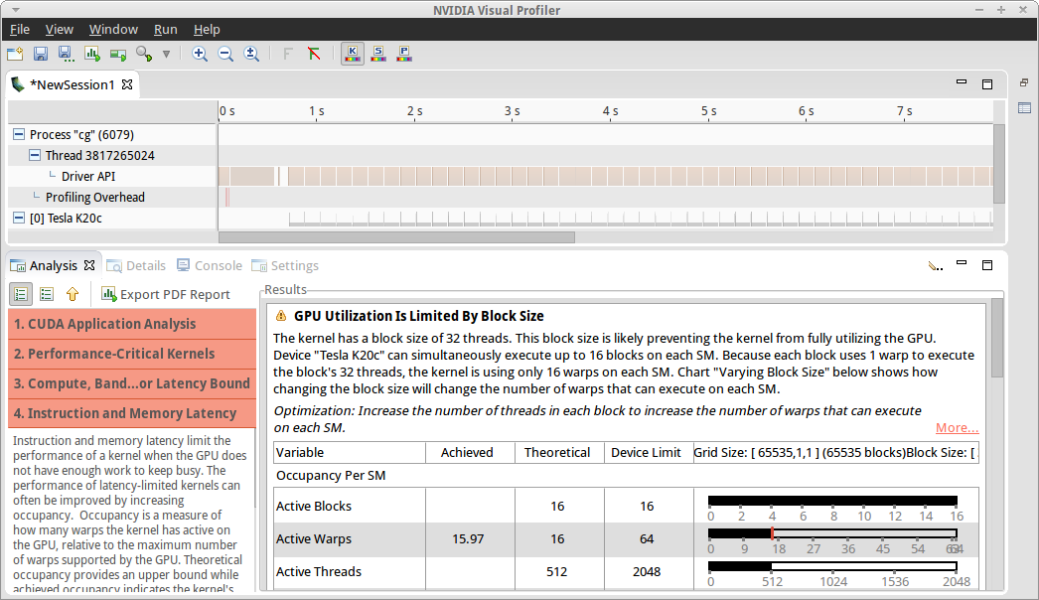
Profiling with Visual Profiler
Visual Profiler Guided Analysis
Performance limited by gang size.

Slide 33
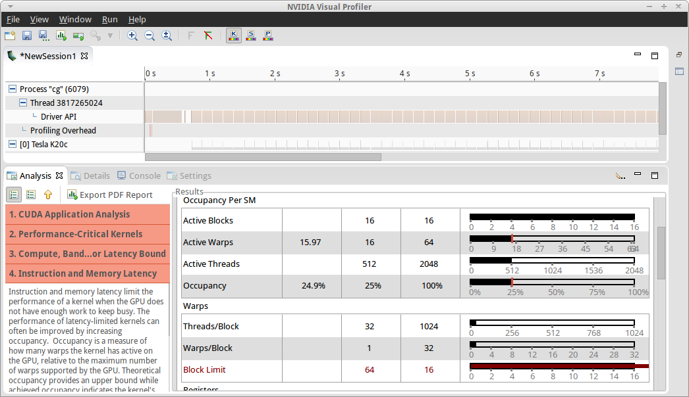
Profiling with Visual Profiler
Visual Profiler Guided Analysis
Small gangs results in low occupancy.

Slide 34
GPU Occupancy
GPU Occupancy is a measure of how well the GPU compute resources are being utilized.
Roughly speaking: Occupancy is…
How much parallelism is running / How much parallelism the hardware could run
100% occupancy is not required for, nor does it guarantee best performance.
Less than 50% occupancy is often a red flag, our occupancy is 25%

Slide 35
Profiling with Visual Profiler
Visual Profiler Guided Analysis
The GPU could run this…

Slide 36
Profiling with Visual Profiler
Visual Profiler Guided Analysis
The GPU could run this…
…but it’s only running this. Why?

Slide 37
Profiling with Visual Profiler
Visual Profiler Guided Analysis
Each gang could have as many as 1024 threads…

Slide 38
Profiling with Visual Profiler
Visual Profiler Guided Analysis
Each gang could have as many as 1024 threads…
…but only has 32 now.

Slide 39
Profiling with Visual Profiler
Visual Profiler Guided Analysis
That means we’d need 64 gangs (blocks) to fill the hardware…

Slide 40
Profiling with Visual Profiler
Visual Profiler Guided Analysis
That means we’d need 64 gangs (blocks) to fill the hardware…
…but it can only hold 16.

Slide 41
Profiling with Visual Profiler
Visual Profiler Guided Analysis
So we need bigger gangs, while keeping a vector length of 32. Let’s add some more workers.

Slide 42
Optimize Loops: Adding Workers
#pragma acc kernels \
present(row_offsets,cols,Acoefs,xcoefs,ycoefs)
{
#pragma acc loop device_type(nvidia) gang worker(32)
for(int i=0;i<num_rows;i++) {
double sum=0;
int row_start=row_offsets[i];
int row_end=row_offsets[i+1];
#pragma acc loop device_type(nvidia) vector(32)
for(int j=row_start;j<row_end;j++) {
unsigned int Acol=cols[j];
double Acoef=Acoefs[j];
double xcoef=xcoefs[Acol];
sum+=Acoef*xcoef;
}
ycoefs[i]=sum;
}
}
Inform the compiler that on NVIDIA GPUs, the outer loop should be broken over gangs and workers, with 32 workers per gang.
Gang size is Workers X Vector Length
This must be no more than 1024 on NVIDIA GPUs

Slide 43
Optimize Loops: Parallel Loop Adding Workers
#pragma acc parallel loop present(row_offsets,cols,Acoefs,xcoefs,ycoefs) \
device_type(nvidia) vector_length(32) \
gang worker num_workers(32)
for(int i=0;i<num_rows;i++) {
double sum=0;
int row_start=row_offsets[i];
int row_end=row_offsets[i+1];
#pragma acc loop reduction(+:sum) \
device_type(nvidia) vector
for(int j=row_start;j<row_end;j++) {
unsigned int Acol=cols[j];
double Acoef=Acoefs[j];
double xcoef=xcoefs[Acol];
sum+=Acoef*xcoef;
}
ycoefs[i]=sum;
}
When using parallel loop, the number of workers is specified at the top of the region.
The gang and worker clauses are then used to inform the compiler to break the look over workers and gangs.

Slide 44
Optimize Loops: Compiler Output
matvec(const matrix &, const vector &, const vector &):
8, include "matrix_functions.h"
15, Generating present(row_offsets[:],cols[:],Acoefs[:],xcoefs[:],ycoefs[:])
17, Loop is parallelizable
Accelerator kernel generated
Generating Tesla code
17, #pragma acc loop gang, worker(32) /* blockIdx.x threadIdx.y */
22, #pragma acc loop vector(32) /* threadIdx.x */
26, Sum reduction generated for sum
22, Loop is parallelizable

Slide 45
Optimize Loops: Final Performance
Time (s)
PGI 15.9 Compiler

Slide 46
Additional Loop Optimizations
Important clauses not used in this example
collapse(N) | Take the next N tightly nested loops and turn them into 1, flattened loop. This is really useful when you have many (> 2-3) nested loops or when your loops are very small.
tile(N[,M,…]) | Break the next loops into tiles/blocks before parallelizing the loops. (See lecture 1 for an example) This is useful for algorithms with high locality, because it encourages reuse of nearby data within each tile.

Slide 47
In Summary
In this lecture we discussed the final 2 steps of accelerating an application using OpenACC
Express Data Movement – Move your data to/from the GPU at a high enough level that the arrays can be reused between functions. (PCIe transfers are expensive!)
Optimize Loops – Apply your knowledge of the code plus feedback from profiling tools to adjust the way that loop iterations are distributed to the hardware.
In the next lecture we’ll discuss asynchronous execution as a way to further improve data movement and performance and also how to interoperate with accelerated libraries and CUDA.

Slide 48
Next Steps & Homework

Slide 49
Homework
This week’s homework will build upon the previous lab by applying the two steps discussed today: Express Data Movement and Optimize Loops.
Go to http://bit.ly/nvoacclab3 from your web browser to take the free lab, or download the code from https://github.com/NVIDIA-OpenACC-Course/nvidia-openacc-course-sources/ to do the lab on your own machine.
If you have not already completed the previous labs, it’s highly recommended that you do http://bit.ly/nvoacclab2 first.

Slide 50
Office Hours Next Week
Next week’s session will be an office hours session.
Bring your questions from this week’s lecture and homework to next week’s session.
If you can’t wait until then, post a question on StackOverflow tagged with openacc.

Slide 51
Oct 1: Introduction to OpenACC
Oct 6: Office Hours
Oct 15: Profiling and Parallelizing with the OpenACC Toolkit
Oct 20: Office Hours
Oct 29: Expressing Data Locality and Optimizations with OpenACC
Nov 3: Office Hours
Nov 12: Advanced OpenACC Techniques
Nov 24: Office Hours
Course Syllabus

